Slide 1
CS 4530: Fundamentals of Software Engineering Module 11.2: Application-Level Patterns
Adeel Bhutta, Rob Simmons and Mitch Wand
Khoury College of Computer Sciences
© 2026 Released under the CC BY-SA license

Slide 2
Learning Objectives for this Lesson
By the end of this module, you should be able to:
describe the basic ideas of the following architectures, with examples and pictures
anarchic
layered
pipeline
event-driven
Microkernel (plug-in)

Slide 3
Three Scales of Design
The Structural Scale
key questions: what are the pieces? how do they fit together to form a coherent whole?
The Interaction Scale
key questions: how do the pieces interact? how are they related?
The Code Scale
key question: how can I make the actual code easy to test, understand, and modify?
Notes:
<Read Slide>
Remember that Design is often an iterative process. Design may happen at all these scales at once.
Think about how each of these different scales might have opportunities to address the different quality goals.

Slide 4
Design at larger scales
Metaphor: building architecture
How do the pieces fit together? Are there parts we can reuse?
Will the result be structurally sound? earthquake-resistant? economical to build? easy to maintain?

Slide 5
Goal: Create a high-level picture of the system
Abstract details away into reusable components
Allows for analysis of high-level design before implementation
Enables exploration of design alternatives
Reduce risks associated with building the software

Slide 6
Architecture #0: Anarchic
A single app, with no particular organization
Also known as: "spaghetti code"
May still have useful interfaces for some degree of encapsulation and modularity.
but is there a method to the madness?
Shakespeare, Hamlet. The exact quote is: "Though this be madness, yet there is method in't" (Polonius, Act 2, Scene 2)
Brian Foote and Joe Yoder
Notes:
emphasizes decentralization, self-organization, and voluntary participation rather than central authority, as seen in open-source software models

Slide 7
Architecture #0: Anarchic
OK for single-developer, short-lived projects
But
what happens if you want to add a new developer
what happens if you need to come back to the code later?
Brian Foote and Joe Yoder

Slide 8
Metaprinciple: Modules and Interfaces
Our system will be made up of modules.
Each module will have one or more clients that utilize its services.
Each module offers a well-defined interface that the clients use when they want to use the services of the module
The modules may be organized in different ways; that's the main topic of this lesson
In practice, modules may or may not be organized as neatly as this slide suggests.

Slide 9
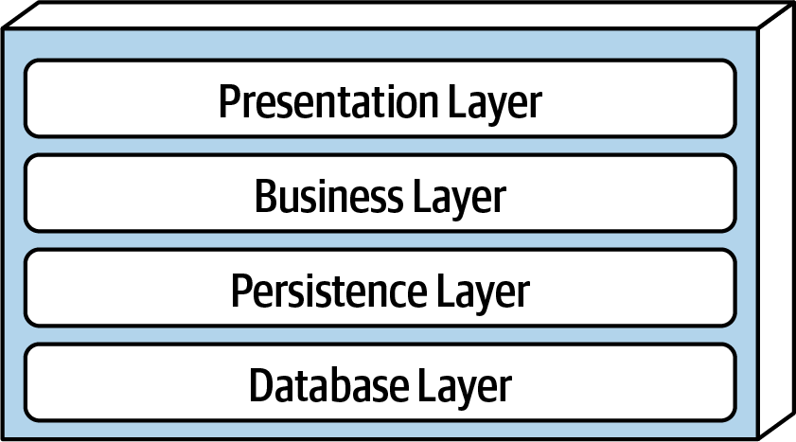
Architecture #1: Layered
Each layer has specific responsibility
Each layer depends on services from the layer or layers below
Organize teams by Layer
different layers require different expertise
When the layers are run on separate pieces of hardware, they are sometimes called "tiers"

Slide 10
Controller-Service-Repository
API
Controller Layer
Service Layer
Repository Layer

Slide 11
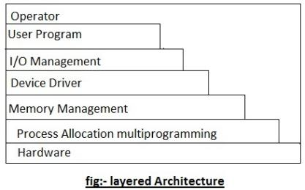
Layered Architecture (contd)
Typical organization for operating systems
Layers communicate through procedure calls and callbacks ("up-calls")
Well-defined interfaces are a must!
Notes:
Examples: web applications using three-tier architectures (presentation, business logic, and data), e-commerce platforms with distinct layers for UI, services, and databases, and mobile applications where each layer handles a specific responsibility like UI, business rules, and data access

Slide 12
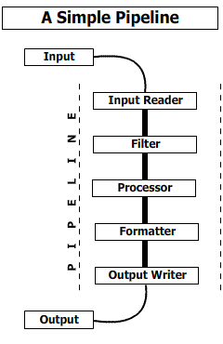
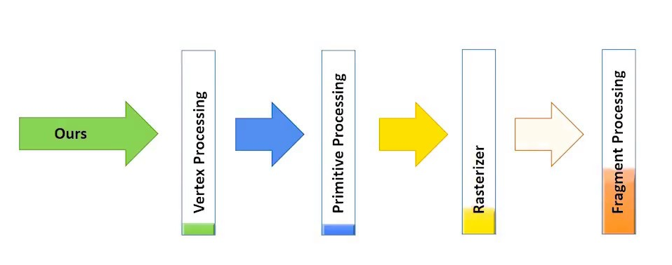
Architecture #2: Pipeline
Modules are arranged in order of processing.
Good for complex straight-line processes, eg image processing
Notes:
Examples: data processing, compilers, AI workflows, multimedia processing, unix command line utilities, build systems

Slide 13
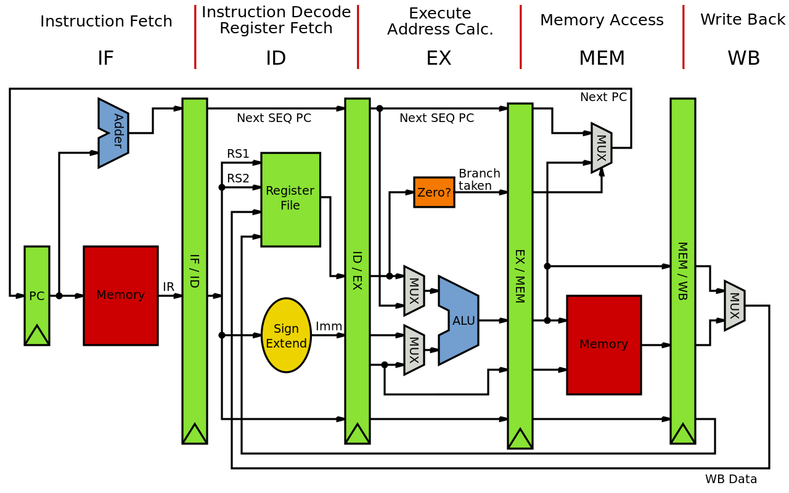
Also good for visualizing hardware

Slide 14
How do the stages communicate?
That's the next-level decision
data-push (each stage invokes the next)
demand-pull (each stage demands data from its predecessor)
queues? buffers?
??
That's what we talked about in Lesson 11.1

Slide 15
In Express, each stage gets an object that represents the rest of the pipeline
app.use((req, res) => {
res.status(404).json({
error: 'Not Found',
message:
`Route ${req.method} ${req.originalUrl} not found`
});
Notes:
res is an object, calling it with .status(404) causes it to emit a 404 immediately, but there are other possibilities.

Slide 16
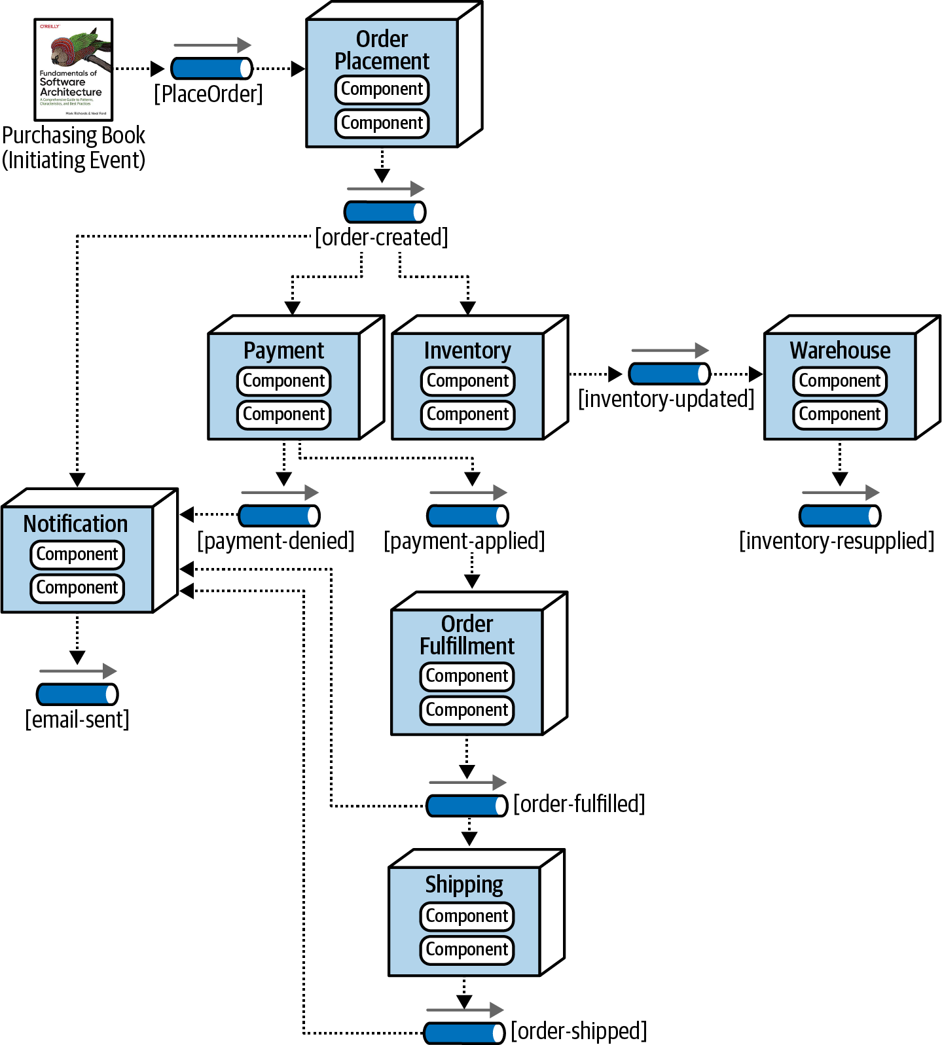
Architecture #3: Event-Driven Architecture
Modules are organized by client's workflow
Each processing unit has an in-box and one or more out-boxes
Each unit takes a task from its inbox, processes it, and puts the results in one or more outboxes.
Stages may be connected by asynchronous message queues
Or use the observer pattern, where each unit observes changes in its upstream units.
Conditional flow
Notes:
Here we have modules aReal-time systems, decoupled systems like e-commerce, IoT or mobile apps (sensors, etc)

Slide 17
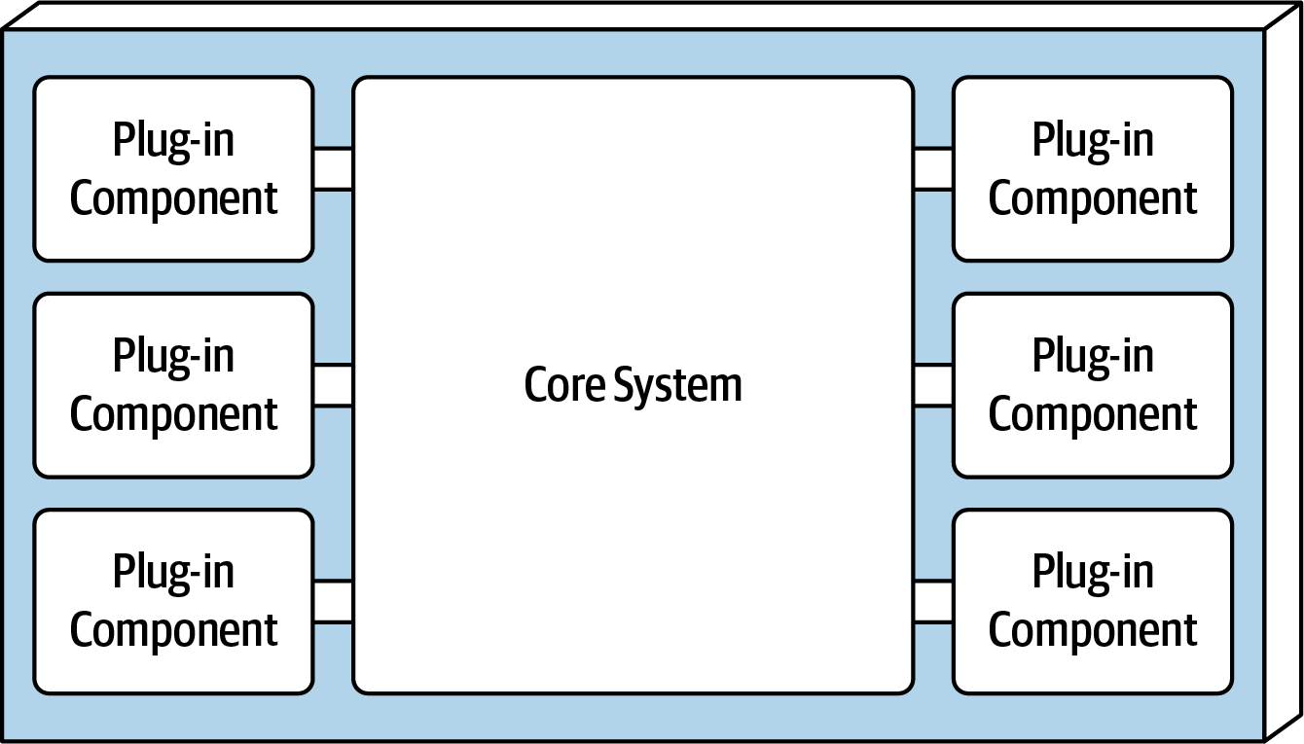
Architecture #4: Plugins ("microkernel")
System consists of a small core (the "microkernel") for essential functions, and lots of hooks for adding other services
Highly extensible
Plug-ins can be designed by small, less-experienced teams– even by users!
Connection methods may vary
often: core provides default behaviors that are overridable
Notes:
IDEs, browsers, Game engines, CMS

Slide 18
Key Concepts for Plugin Architecture
Activation Events: when does your extension run?
Host API: what procedures in the host app can your extension call?
Contribution Point: what your extension contributes to the host (e.g. new commands, menus, pipeline stages, etc.)

Slide 19
Example 1: git hooks
git provides a fixed set of activation events (files in .git/hooks)
the user can extend git's default behavior by changing these files
$ cat .git/hooks/pre-merge-commit.sample
#!/bin/sh
#
# An example hook script to verify what is about to be committed.
# Called by "git merge" with no arguments. The hook should
# exit with non-zero status after issuing an appropriate message to
# stderr if it wants to stop the merge commit.
#
# To enable this hook, rename this file to "pre-merge-commit".
. git-sh-setup
test -x "$GIT_DIR/hooks/pre-commit" &&
exec "$GIT_DIR/hooks/pre-commit"
:

Slide 20
Example 2: express
export const createApp = (): express.Application => {
const app = express();
// Middleware for parsing JSON requests
app.use(express.json());
// Addition endpoint
app.get('/sum/:i/:j', getSum);
// get the rest of the routes from frontend/dist
app.use(express.static('frontend/dist'));
app.use((req, res) => {
res.status(404).json({
error: 'Not Found',
message: `Route ${req.method} ${req.originalUrl} not found`
});
});

Slide 21
Architecture #5: Microservices
Strategy: break up the task into many small services, which communicate as needed.
Each service should be
independently replaceable,
independently updatable
Advantage:
different components may run on different hardware/software
may scale differently
Components can be built as libraries, but more usually as web services
Services communicate via HTTP

Slide 22
Microservices: Schematic Example
Different languages, different operating systems
NodeJS, MongoDB
Google Service
Java, MySQL
Mod 1
Mod 2
Mod 3
Todos
Logins
Mailer
REST service
REST service
REST service
Productivity App
Database
Database
Database
Frontend
REST
Search Engine
Analytics
Social Crawler
“Dumb”
App Server
Mod 4
Mod 5
Mod 6
REST service
REST service
REST service
Database
Database
Database
Java, Neo4J
C#, SQLServer
Python, MongoDB

Slide 23
Microservice Advantages and Disadvantages
Advantages
services may scale differently, so can be implemented on hardware appropriate for each (how much cpu, memory, disk, etc?). Ditto for software (OS, implementation language, etc.)
services are independent (yay for interfaces!) so can be developed and deployed independently
Disadvantages
some transactions may span multiple components. How to maintain consistency?
service discovery?
should services have some organization, or are they all equals?
overall system complexity

Slide 24
Microservices are (a) highly scalable and (b) trendy
Microservices at Netflix:
100s of microservices
1000s of daily production changes
10,000s of instances
BUT:
only 10s of operations engineers
https://medium.com/refraction-tech-everything/how-netflix-works-the-hugely-simplified-complex-stuff-that-happens-every-time-you-hit-play-3a40c9be254b (2017)

Slide 25
Review
You should now be able to:
describe the basic ideas of the following architectures, with examples and pictures
anarchic
layered
pipeline
event-driven
microkernel

